Slide 1
RDz Workbench – File Manager Integration
Jon Sayles, IBM Software Group, Rational EcoSystems Team

Slide 2
IBM Trademarks and Copyrights
© Copyright IBM Corporation 2007,2008, 2009. All rights reserved.
The information contained in these materials is provided for informational purposes only, and is provided AS IS without warranty of any kind, express or implied. IBM shall not be responsible for any damages arising out of the use of, or otherwise related to, these materials. Nothing contained in these materials is intended to, nor shall have the effect of, creating any warranties or representations from IBM or its suppliers or licensors, or altering the terms and conditions of the applicable license agreement governing the use of IBM software. References in these materials to IBM products, programs, or services do not imply that they will be available in all countries in which IBM operates.
This information is based on current IBM product plans and strategy, which are subject to change by IBM without notice. Product release dates and/or capabilities referenced in these materials may change at any time at IBM’s sole discretion based on market opportunities or other factors, and are not intended to be a commitment to future product or feature availability in any way.
IBM, the IBM logo, the on-demand business logo, Rational, the Rational logo, and other IBM Rational products and services are trademarks or registered trademarks of the International Business Machines Corporation, in the United States, other countries or both. Other company, product, or service names may be trademarks or service marks of others.

Slide 3

Course Contributing Authors
Thanks to the following individuals, for assisting with this course:
  David Bean/IBM
  Russ Courtney/IBM

Slide 4
Course Overview
Audience
  This course is designed for application developers who have learned or programmed in COBOL, and who need to do z/OS Traditional Development and Maintenance as well as build leading-edge applications using COBOL and Rational Developer for System z.
Prerequisites
  This course assumes that the student has a basic understanding and knowledge of software computing technologies, and general data processing terms, concepts and vocabulary, as well as a working knowledge of COBOL and z/OS.
  Knowledge of SQL (Structured Query Language) is assumed for database access is assumed as well.
  Basic PC and mouse-driven development skills, terms and concepts are also assumed.

Slide 5
Course Topics
Course Name: Rational Developer for System z (RDz) Foundation Training
Course Description: Learn how to use Rational Developer for System z to do z/OS traditional development, maintenance, support and for Enterprise Modernization of z/OS applications
Pre-requisites: Some experience developing COBOL applications using z/OS is expected. A working knowledge of SQL is also recommended.
Course Length: ~5days – or if done in self-paced mode at your own pace
Topics (Agenda)
    Getting Started - installing and configuring RDz - and the course materials, and using Eclipse
    The RDz Workbench
      Code analysis tools
      Editing
      Compiling programs
      Debugging local COBOL programs
    The Data Perspective:
      Working with relational data sources
      Modifying test data
      Editing and testing SQL statements
    Working with remote system resources:
      Connecting to a mainframe
      Data management
      Accessing and editing files
    z/OS Application Development
      Creating MVS Subprojects
      Creating and customizing project properties
    Debugging z/OS Applications
      Debugging Batch Applications
      Setting Debug Tool for Online Applications
    Working with File Manager
      Creating test data
      Editing complex file-types
    Working with mainframe ABENDs using Fault Analyzer
      Creating Fault History views
      Analyzing and solving mainframe ABENDs
    Creating and modifying BMS Maps using the BMS Map Editor

Slide 6
The RDz Workbench
UNIT
Topics:
Using File Manager with z/OS Test Data Files
Appendix

Slide 7
Topic Considerations
After completing this unit, you should be able to:
  Describe the key features functions of IBM's File Manager
  Describe how to work with copybooks as templates for complex data structures
  Describe how to display/read/delete/update data from complex QSAM and VSAM files
 Note: In this topic you will learn how to use IBM File Manager to work with z/OS files. The screen captures all describe connecting to a public z/OS machine that IBM makes available – during classes.
If you are taking this course through standard IBM services delivery you should be able to use the properties (I/P address, port#s, etc.), logon IDs and passwords that your instructor provides you with.
But you may also be taking this course standalone – and in that case, you will need to speak to your company's Systems Programming staff to learn how to connect and logon.
It goes without saying that the actual file names in the screen captures of mainframe libraries and datasets will vary. So you should focus on the process and steps and "how to" – and don't be perplexed at differences in screen captures.

Slide 8

What is File Manager?
A z/OS toolset for working with z/OS®, DB2®, IMS™, and CICS® data.
  Display, edit, update, create, copy, compare, print and erase your data files with this member of the IBM Problem Determination Tools suite.
  Includes the familiar browse, edit, copy and print utilities found in ISPF—enhanced to meet the needs of your application developers
  Manipulates data using COBOL and PL/I record layouts interactively or in batch
  Runs functions from your CICS environment
  Provides access to CICS resources with a familiar, user-friendly ISPF look-alike interface
  Provides customization of which fields to display, copy or print
  Integration with Rational Developer for System z enables developers to access files and databases without changing user interface
QSAM
VSAM
DL/I
DB2
CICS
Edit
Copy
Update
Delete
Compare
Print
etc.
See Notes
Notes:
See: http://www-01.ibm.com/software/awdtools/filemanager/ - for File Manager product installation and documentation

Slide 9

RDz/File Manager Integration
File Manager runs standalone on z/OS as an ISPF option under TSO
But it also integrates into RDz through a series of eclipse views which provide an interface for managing remote test files.
There is no one-single File Manager view. Instead it's facilities are integrated into a number of RDz functions
The File Manager facilities allow you to (from within RDz):
  Define and connect to remote z/OS files
  Assign datasets to templates for editing and record-level test data generation
  Allocate data sets
  Subset datasets through templates
  Create or delete members
  Display and edit the following dataset formats
    PDS Members
    Sequential Data Sets
      Fixed length
      Variable length
    VSAM Data Sets:
      ESDS
      KSDS
Note also that, File Manager's Host Emulation interface allows you to edit:
  DB2 data structures
  IMS (DL/I) databases
  CICS data areas
Notes:
Connecting to a z/OS host from the workbench
Module 4 - Development of Local COBOL Programs
The Formatted Data Editor provides similar functionality to that of the IBM® File Manager ISPF data set editor, however Developer for System z™ File Manager’s editor takes advantage of the GUI environment to provide a more user friendly experience. It provides the ability to display and edit PDS members, Sequential data sets, and VSAM data sets in a formatted view based on record layouts for the data derived from data structures stored within a COBOL copybook, PL/I include, or an IBM File Manager template. The editor offers the same three modes to view data in as IBM File Manager (single, character, and table), and given the same data set and template, will format the data in the same way as the IBM File Manager editor. However, there are some limitations on Developer for System z File Manager’s functionality that keep it from doing so in all cases. For more on this, see the Limitations section. For more information about IBM File Manager’s ISPF data set editor, see the IBM File Manager User’s Guide.

Slide 10
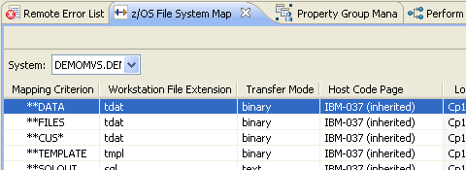
File Manager and z/OS File Mappings
File Manager uses two z/OS File System Mappings:
  1 .tdat file - used to identify the file as containing program data (instead of program source)
    If the .tdat file is a PDS, then all members are marked with the extension
    Default editor is the Formatted Data Editor
  2 .tmpl file - used to identify a PDS member as an IBM File Manager Template
    Templates are created using IBM File Manager and are based upon a COBOL copybook or PL/1 include file
What's up with this z/OS File Mapping System?
Notes:
Connecting to a z/OS host from the workbench
Module 4 - Development of Local COBOL Programs

Slide 11
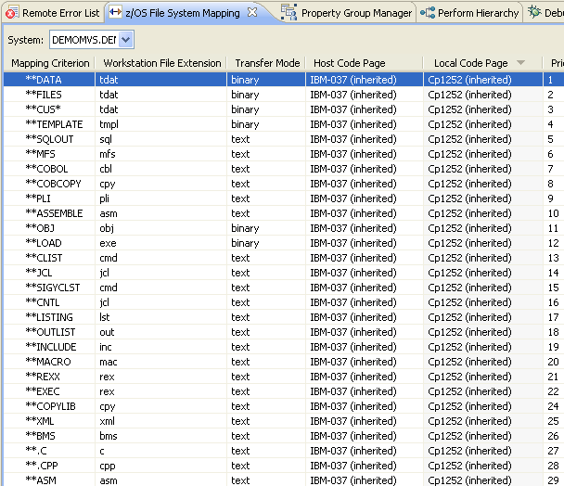
What is the z/OS File Mapping?
RDz provides a property file for you to assign a mapping criterion (name/type/transfer, etc.) to a z/OS file category:
  COBOL
  JCL
  COPY
  Assembler
  Load
  Etc.
Using File Mapping you can:
Customize the behavior of RDz to match your shop's file naming standards
Define how RDz interacts with a given type of file
We've used the File Mapping System's defaults for all our file types and datasets to-date (esp. for source files)
But data files rarely adhere to a universal a naming standard. So you will have to define custom file mappings for your data files in order for RDz to understand how to treat them
Notes:
Connecting to a z/OS host from the workbench
Module 4 - Development of Local COBOL Programs

Slide 12
Steps in Using File Manager – Basic***
0. Be sure your copybooks are available for use as edit masks
1. Create .tmpl (template) files for test dataset views
2. Set up z/OS File Mappings for "test data" datasets
3. Assign datasets to copybooks or template files
4. Edit files
*** Note that we use the term "Basic" because there is a lot of advanced File Manager dataset functionality beyond the scope of this unit.
Consult the File Manager documentation or RDz Help for assistance learning.
Notes:
Connecting to a z/OS host from the workbench
Module 4 - Development of Local COBOL Programs
The Formatted Data Editor provides similar functionality to that of the IBM® File Manager ISPF data set editor, however Developer for System z™ File Manager’s editor takes advantage of the GUI environment to provide a more user friendly experience. It provides the ability to display and edit PDS members, Sequential data sets, and VSAM data sets in a formatted view based on record layouts for the data derived from data structures stored within a COBOL copybook, PL/I include, or an IBM File Manager template. The editor offers the same three modes to view data in as IBM File Manager (single, character, and table), and given the same data set and template, will format the data in the same way as the IBM File Manager editor. However, there are some limitations on Developer for System z File Manager’s functionality that keep it from doing so in all cases. For more on this, see the Limitations section. For more information about IBM File Manager’s ISPF data set editor, see the IBM File Manager User’s Guide.

Slide 13
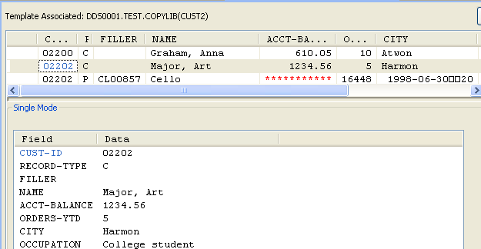
0. Copybooks For Edit Masks
There are a number of editing modes that File Manager supports, but one of the most useful – especially for large or complex datasets is editing through a copybook or template (.tmpl) file
The file is presented one-record-at-a-time, and the copybook/template breaks the record's individual fields out on separate lines
This makes is it easy to visualize the file structure and change data values
In order to enable editing through copybook masks you will need copybooks:
That match the file structure and size (including FILLER out to the end of the LRECL) and that compile clean
Table
Record
Structure
Copybook
Record
Structure
Notes:
Connecting to a z/OS host from the workbench
Module 4 - Development of Local COBOL Programs

Slide 14

1. Create .tmpl (templates) out of Copybooks – 1 of 4
What is a .tmpl (template) file?
A template file is a file-editing mask, built from a copybook that allows you to:
Browse and edit data through masks (previous screen)
Create test data subsets of a file
Handle variable length data files conditionally - with different 01 group definitions assigned to the different logical views of each physical record
Edit packed and binary data in records
Different
Record
Layouts
Data edited through
specific
record's
01 definition
Test
Data
File
Conditional
template
selection
Test
Data
Subset
Record Filter
Notes:
Connecting to a z/OS host from the workbench
Module 4 - Development of Local COBOL Programs

Slide 15
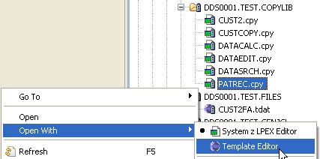
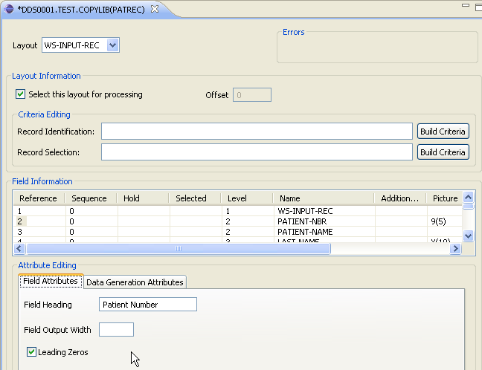
1. Create .tmpl (templates) out of Copybooks – 2 of 4
How to create a template file:
Select the copybook file from RSE you wish to turn into a template
Right-click and select Template Editor
Specify template properties
If a variable length file, click Build Criteria next to Record Identification
If you wish to subset your test data, click Build Criteria next to Record Selection
For each field you may customize:
The field heading
(if numeric) whether to show or hide leading zeros
What data to use, if creating new records
  Data Generation Attributes
See Notes
Notes:
Connecting to a z/OS host from the workbench
Module 4 - Development of Local COBOL Programs
if the data contains multiple record types they would select the Record Identification button to specify the copybook field which is used to distinguish one record from another, and the value which should be used to identify that specific record type

Slide 16
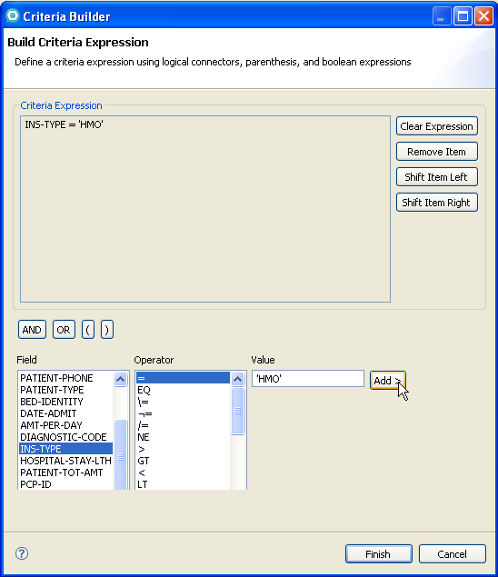
1. Create .tmpl (templates) out of Copybooks – 3 of 4
The Build Criteria Expression dialog allows you to:
Select a field within the record
Select a comparison operator
Specify a literal value
Create complex AND/OR and parenthesized expressions – for carving out specific record subsets within large files
Your expressions become a conditional test each dataset record must pass in order to be viewed through the named template
Notes:
Connecting to a z/OS host from the workbench
Module 4 - Development of Local COBOL Programs
The Formatted Data Editor provides similar functionality to that of the IBM® File Manager ISPF data set editor, however Developer for System z™ File Manager’s editor takes advantage of the GUI environment to provide a more user friendly experience. It provides the ability to display and edit PDS members, Sequential data sets, and VSAM data sets in a formatted view based on record layouts for the data derived from data structures stored within a COBOL copybook, PL/I include, or an IBM File Manager template. The editor offers the same three modes to view data in as IBM File Manager (single, character, and table), and given the same data set and template, will format the data in the same way as the IBM File Manager editor. However, there are some limitations on Developer for System z File Manager’s functionality that keep it from doing so in all cases. For more on this, see the Limitations section. For more information about IBM File Manager’s ISPF data set editor, see the IBM File Manager User’s Guide.

Slide 17
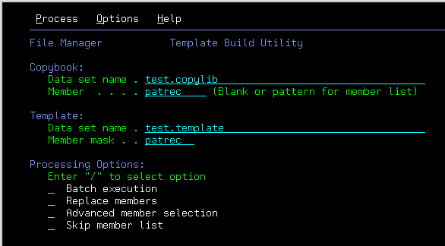
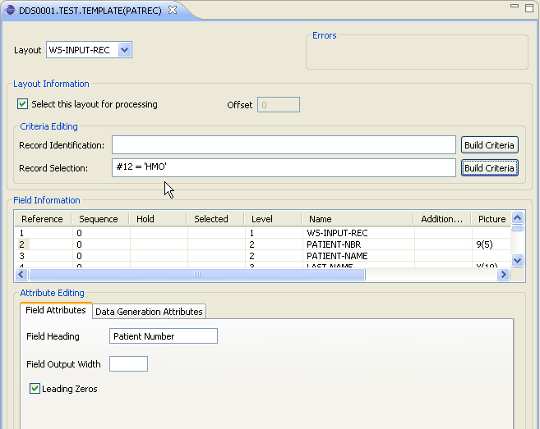
1. Create .tmpl (templates) out of Copybooks – 4 of 4
Another alternative, is to combine the File Manager mainframe (ISPF) panel functionality with RDz workstation facilities
Use the mainframe File Manager utilities to create templates from copybooks
Edit/Extend the templates using RDz
Notes:
Connecting to a z/OS host from the workbench
Module 4 - Development of Local COBOL Programs
The Formatted Data Editor provides similar functionality to that of the IBM® File Manager ISPF data set editor, however Developer for System z™ File Manager’s editor takes advantage of the GUI environment to provide a more user friendly experience. It provides the ability to display and edit PDS members, Sequential data sets, and VSAM data sets in a formatted view based on record layouts for the data derived from data structures stored within a COBOL copybook, PL/I include, or an IBM File Manager template. The editor offers the same three modes to view data in as IBM File Manager (single, character, and table), and given the same data set and template, will format the data in the same way as the IBM File Manager editor. However, there are some limitations on Developer for System z File Manager’s functionality that keep it from doing so in all cases. For more on this, see the Limitations section. For more information about IBM File Manager’s ISPF data set editor, see the IBM File Manager User’s Guide.

Slide 18
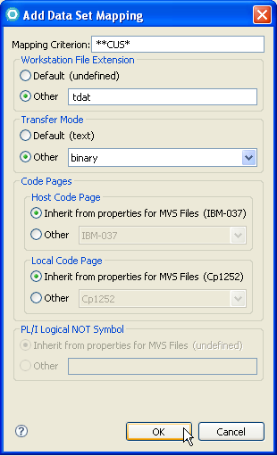
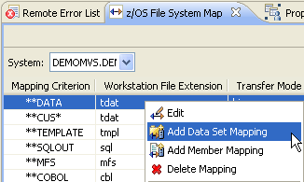
2. Set up z/OS File Mappings for test datasets
As mentioned previously, your test datasets will most likely require custom z/OS File Mapping, in order for RDz to understand how to interact with the file (i.e. how to download, how to edit etc.).
It's easy to setup a new, custom Data Set Mapping:
1. From the z/OS File System Map view:
  Right-Click
  Select Add Data Set Mapping
2. Specify the mapping characteristics ➔
Mapping Criterion:
  Each asterisk (*) is a wildcard for a file name level – or suffix
  So **CUS* - means <anyHLQ>.<any2ndLevelQ>.CUS … any suffix
Workstation file extension (as a file type label)
The file transfer protocol:
  Text – for ASCII source files
  Binary – for test data datasets
Notes:
Connecting to a z/OS host from the workbench
Module 4 - Development of Local COBOL Programs

Slide 19
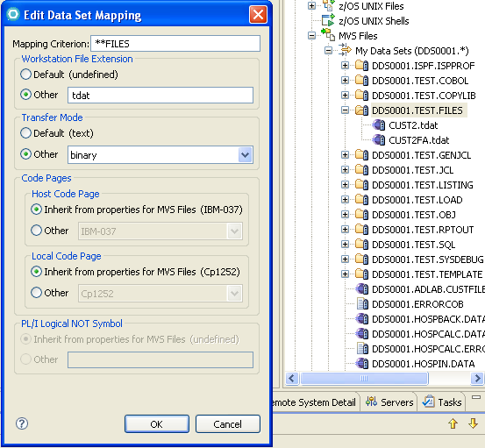

2. Set up z/OS File Mappings for test datasets
In this example, we have created a Mapping for all datasets named:
  <anyHLQ>.
  <any2ndLevelQ>.
  FILES
  Ex. DDS0001.TEST.FILES
And if the file is a PDS?
The members inherit the mapping
Note that after you successfully add a new z/OS File Mapping for dataset, the default icon associated with file will change
Notes:
Connecting to a z/OS host from the workbench
Module 4 - Development of Local COBOL Programs

Slide 20
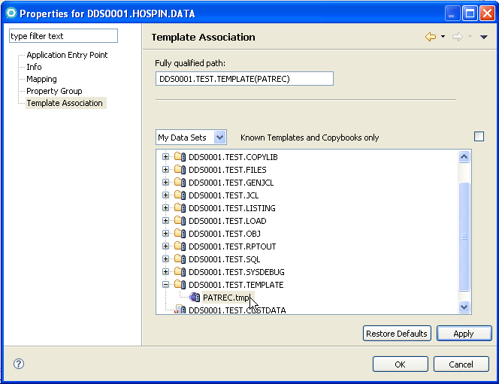
3. Assign datasets to copybooks or template files
As mentioned, there are a number of different editing options for File Manager to use on your dataset. In order for RDz and File Manager to utilize a specific copybook or template file – do the following for each file:
From RSE:
Right Click on the file
Choose Properties
From: Properties Dialog
Highlight Template Association➔
Enter the Fully qualified path of the copybook or template file
Or, browse for the Template / Copybook dropdown - selection set for the template or copybook file name
Slide Notes
Notes:
Connecting to a z/OS host from the workbench
Module 4 - Development of Local COBOL Programs
The difference between using a template …versus a copybook is that a template can capture far more valuable record editing semantics (which a copybook can not)
Examples:
Record subset
Variable record selection
Custom field headings
Showing leading zeroes
Default data for new (Added) rows

Slide 21

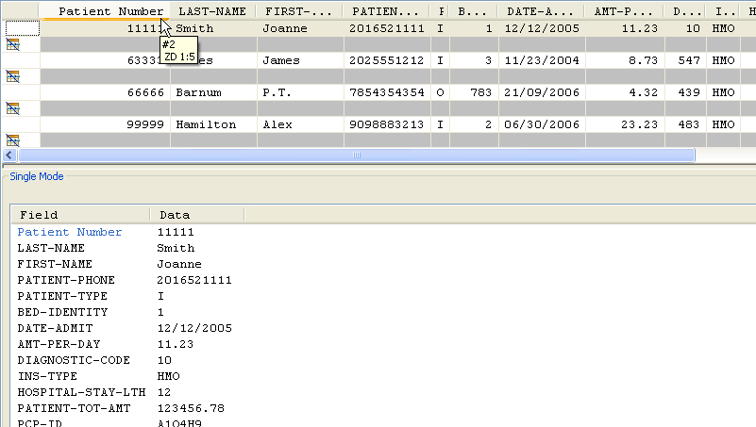

4. Edit
Custom Field Heading
Here is a file seen through a filtering,
template
Mouse-over the column-headers shows the field definition
'HMO'
record
Selection
Can edit in table-mode
…or record mode
Ctrl/S – to save editing changes to the file
Slide Notes
Notes:
Connecting to a z/OS host from the workbench
Module 4 - Development of Local COBOL Programs
Note: ZD 1:5 = Zoned Decimal, starts at byte 1 for 5 bytes

Slide 22
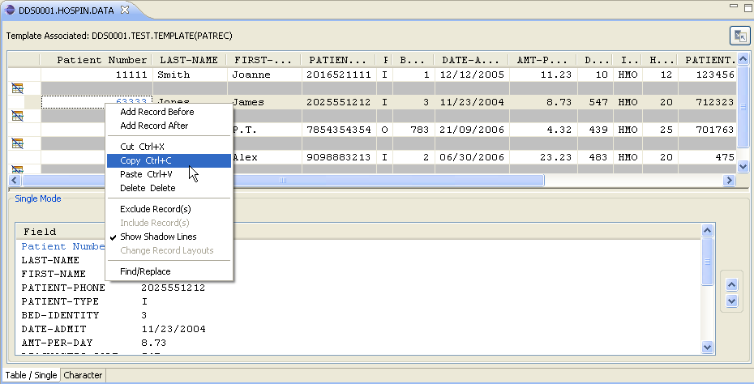
4. Edit Files – Additional Edit Menu Capabilities
Note the following:
  New record (Add operation will utilize Data Generation Attributes of template)
  Alternate row color (dark gray) ✓ Show Shadow Lines
  Cut/copy/paste
    Field values and/or cut/copy/paste entire record
Page up/down one record at a time ➔
Slide Notes
Notes:
Shadow lines are simply alternate line (record) colors. Added to help you distinguish rows visually.

Slide 23
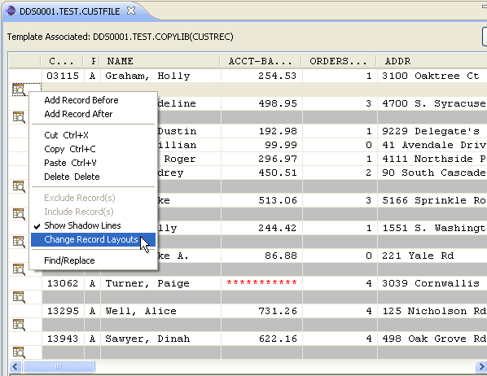
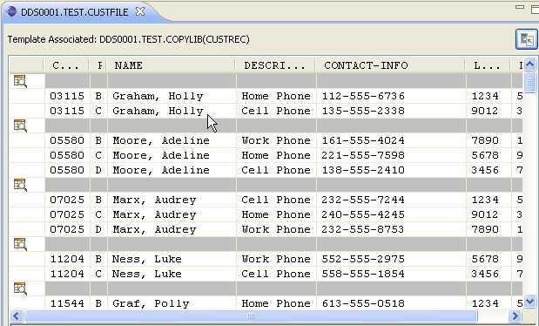
4. Edit Files – Use of Template With Variable Length Files
Record Identification
Criteria for choosing one type of 01 file layout versus another in a variable length file in a template
During Edit:
Select a "grayed out" record
Right-click, and from the context menu
Select: Change Record Layouts

Slide 24
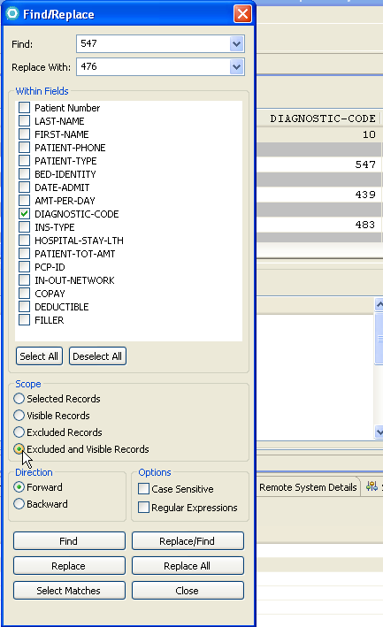
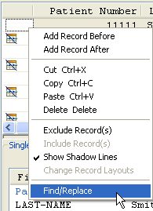
4. Edit Files – Find/Replace
Powerful Find/Replace:
  Persistent data values in drop-downs
  Limit operation to specific field(s)
  Scope operation to specific records
    Visible
    Excluded records
    All
  Use regular expressions for "like" record matching
  "Mode-less" dialog
    Can continue Find/Replace along-side other edit operations

Slide 25
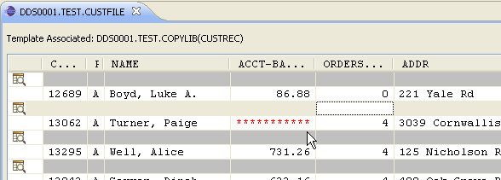
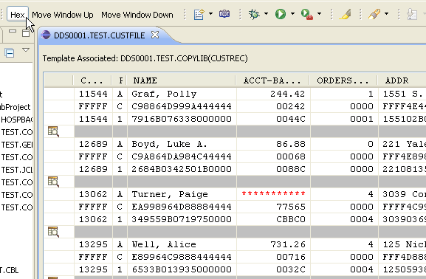
4. Edit Files – Hex and Invalid Data
Invalid numeric data shows up as red asterisks in field during normal table/record display mode
Can verify with Hex toggle button in the Content Area toolbar
Invalid Packed Data in ACCT-BALANCE

Slide 26
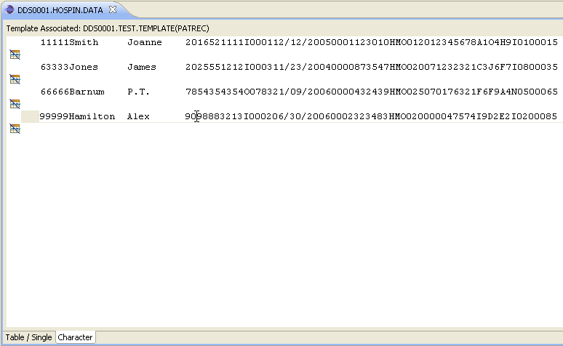
4. Edit Files – Character Edit-Mode
Toggle Table/Record viewing mode with line/text "Character" mode
Unformatted data display
Useful for power data-entry of zoned-decimal and PIC X field data
Not particularly useful with Packed or Binary data ☺

Slide 27
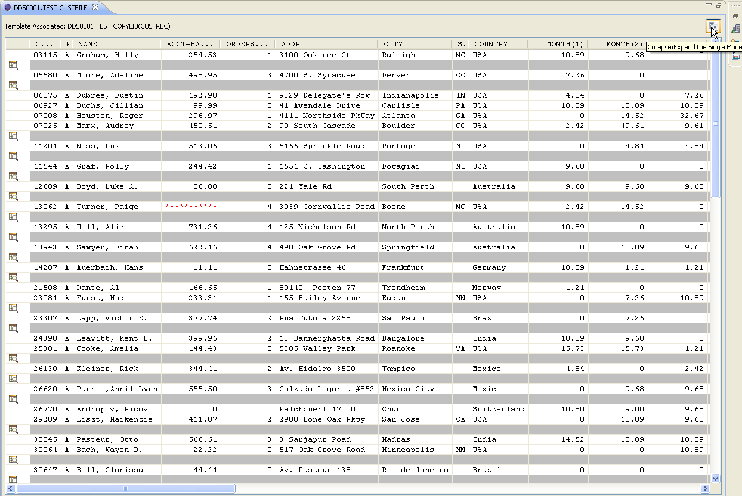
4. Edit Files – Collapse/Expand Table and Single Record Modes
Can view/edit extremely large amount of data at-a-glance.

Slide 28
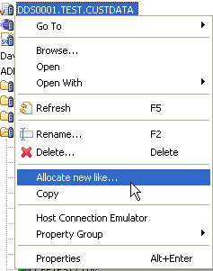
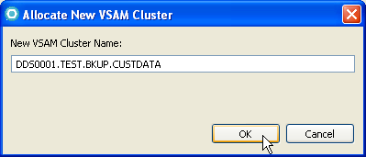
File Manager – Dataset Management Capabilities
File Manager provides functionality to:
  Allocate a new dataset modeled after an existing DSN
    For QSAM or VSAM
  Copy a dataset and its’ contents to a new DSN
    In the current LPAR
    Through a different connection to a different LPAR
  Delete a dataset
  Rename a dataset
  Browse a dataset
  Open a dataset with various editors
    Defaults to the Formatted Data Editor
  Assign different dataset templates through Properties
Notes:
Connecting to a z/OS host from the workbench
Module 4 - Development of Local COBOL Programs

Slide 29
Summary
Having completed this unit, you should now be able to:
  Describe how to locate files on the host
  Describe how to work with copybooks and templates
  Describe how to allocate VSAM files modeled after other VSAM file structures
  Describe how to display/read/delete/update data from:
    QSAM fixed length files
    QSAM variable length files
    VSAM files
      KSDS
      ESDS
Notes:
Connecting to a z/OS host from the workbench
Module 4 - Development of Local COBOL Programs

